Slide 1
COMPUTER SCIENCE 110
Introduction To Computers and Python Programming
Jeffrey McDowell | Leo Hayes High School

Slide 2
00
Zero Day - Welcome

Slide 3
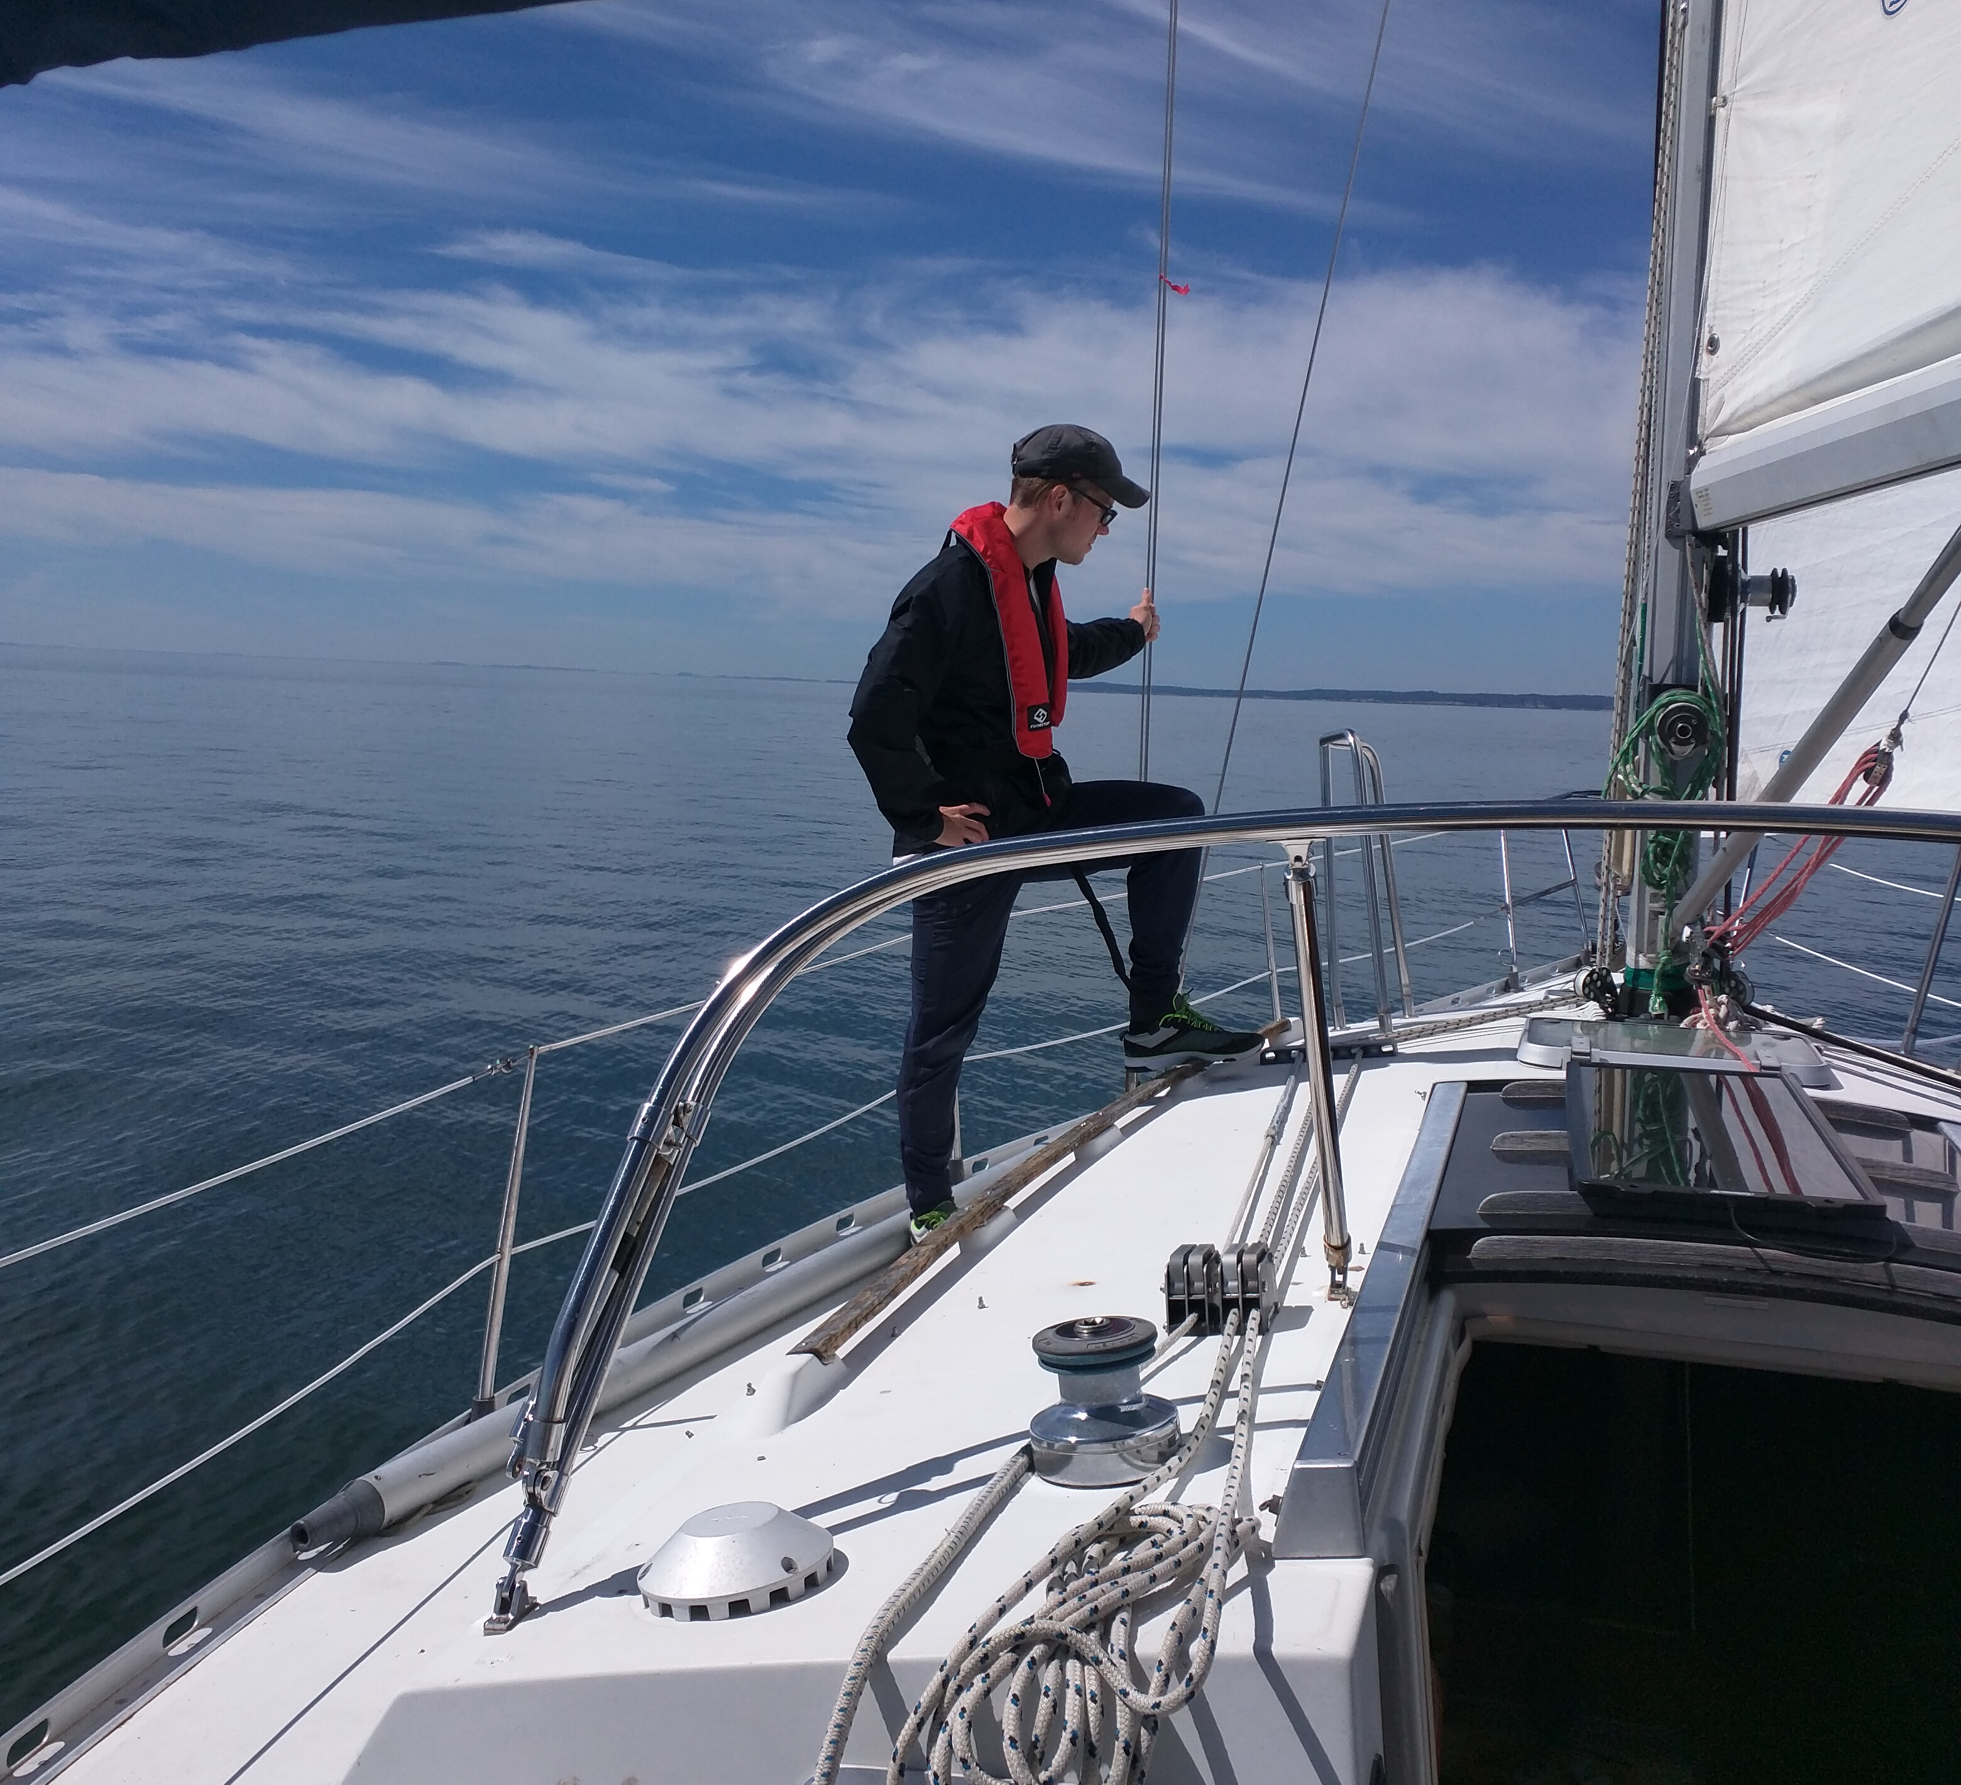

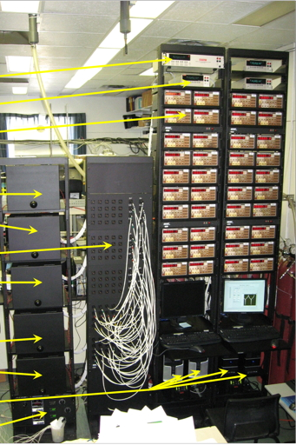
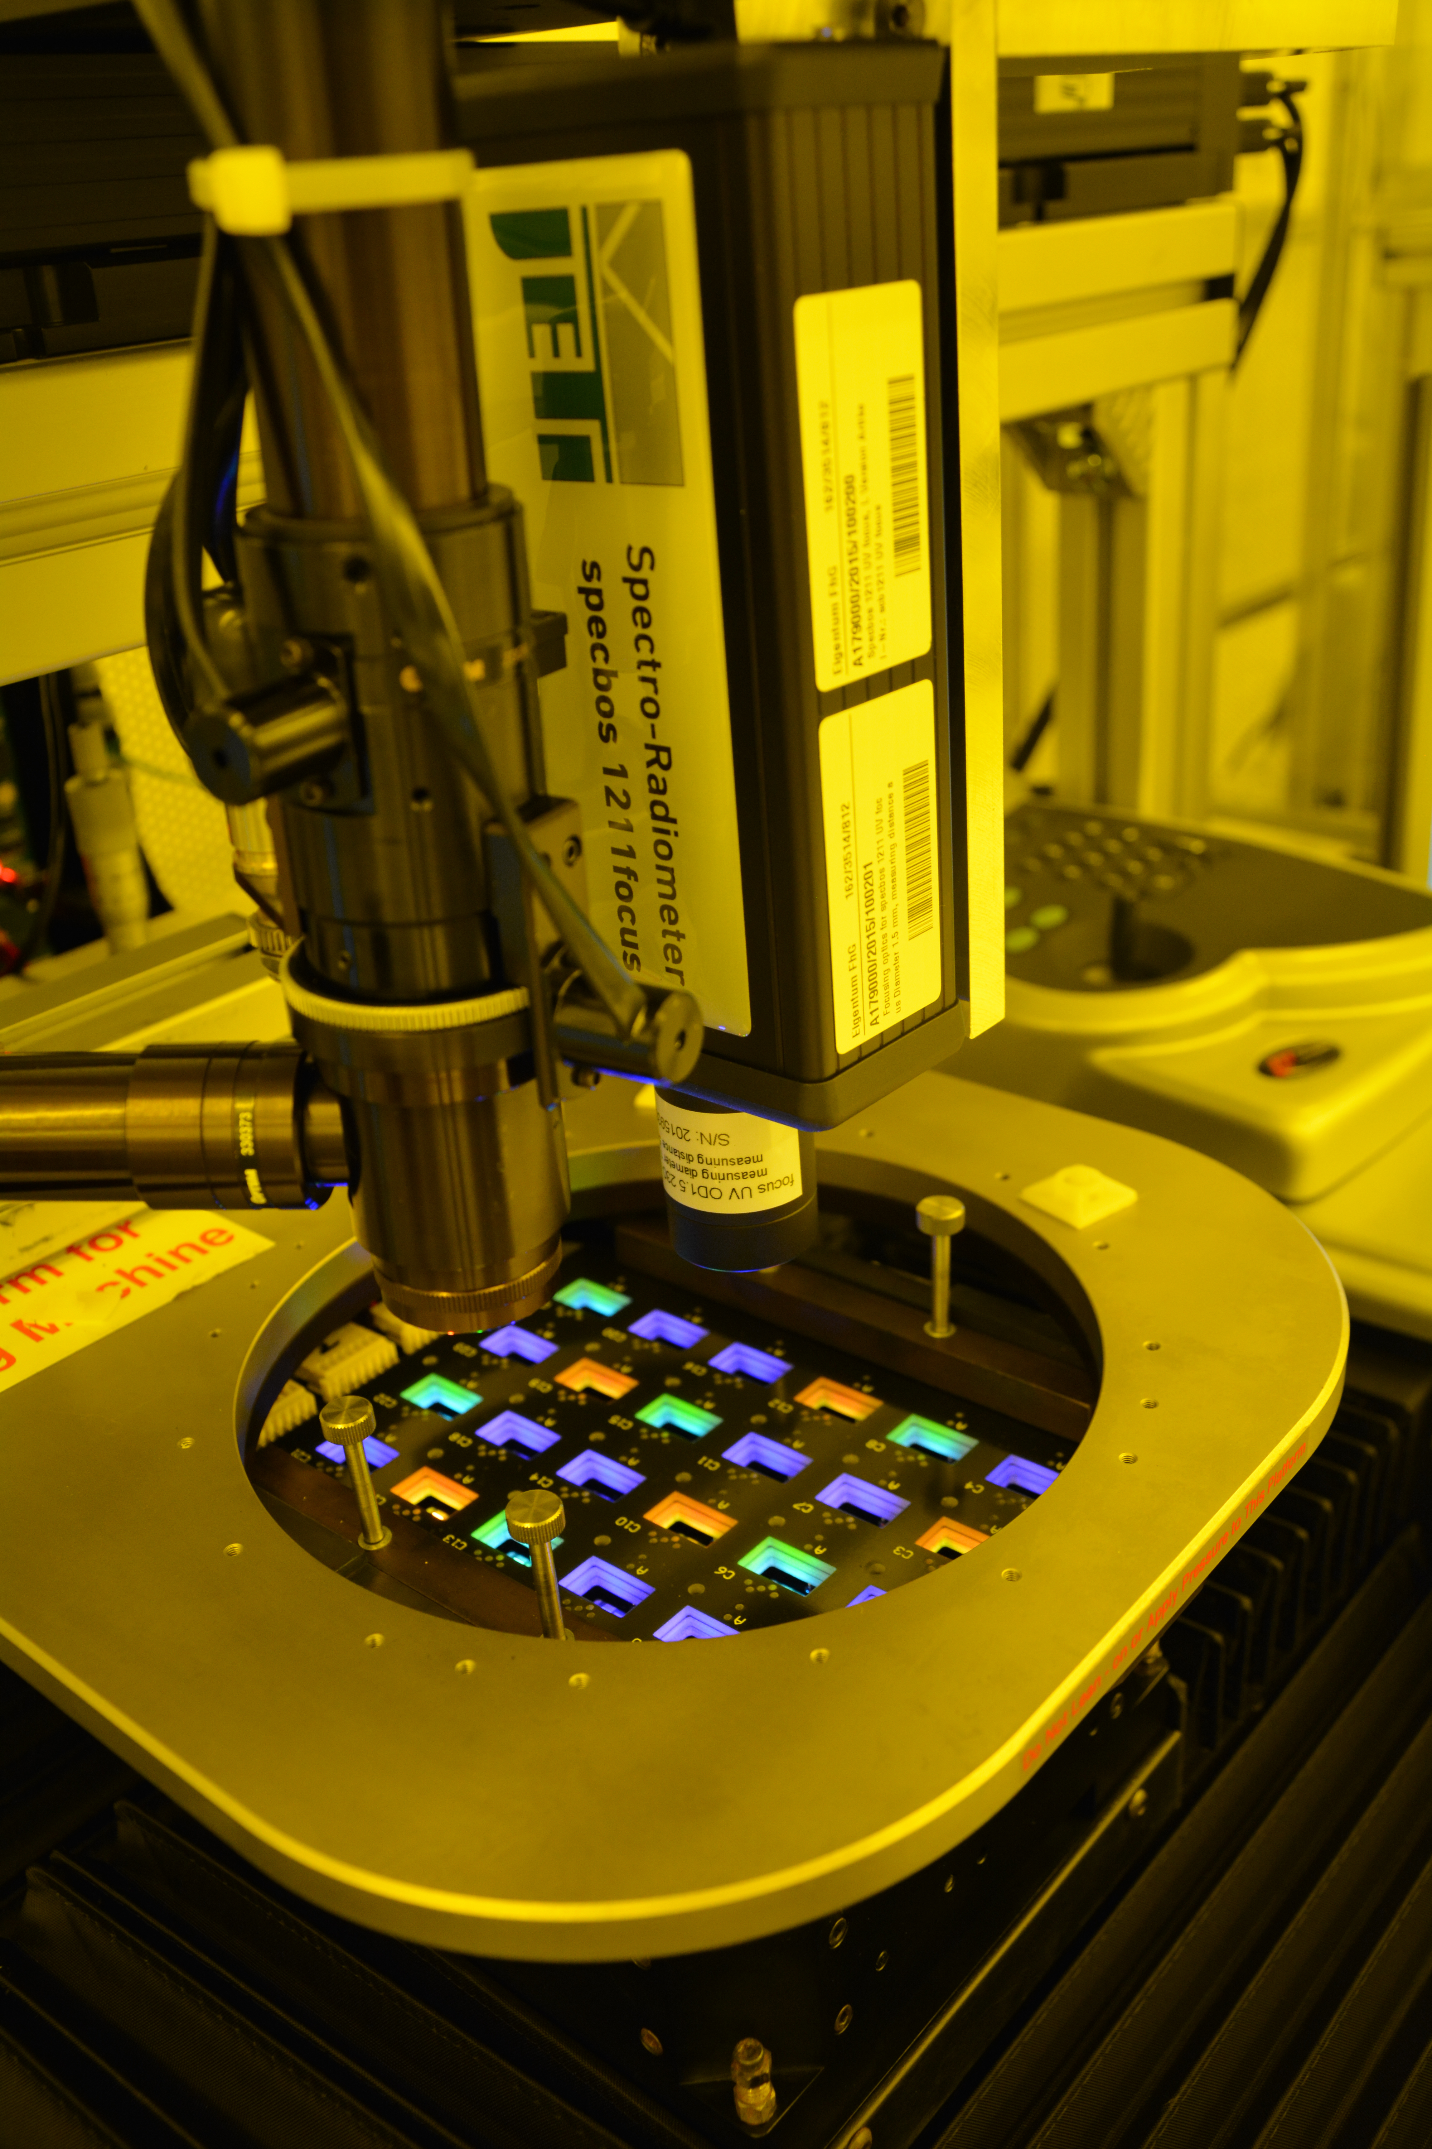
About Your Instructor
J. McDowell, PhD
Education:
B.Sc. Chemistry (UNB 2003-2007)
PhD Chemistry (UofT, 2007-2013) – OLEDs
Research Career:
UofT, Toronto - 3rd Gen Photovoltaics
Johns Hopkins, Baltimore – Li-Ion Batteries
Max Planck , Germany – SS Li-Ion Batteries
Station F, Paris, France – Electric Vehicle
How To Contact Me
Email: Jeffrey.mcdowell@nbed.nb.ca
Github: Raise An Issue and Point It Towards Me

Slide 4


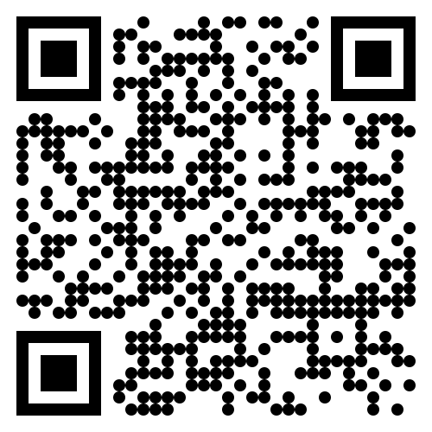
What To Expect From This Course
Outcome 01 | Understanding Computer Hardware and Its Role in Programming | 20%
Outcome 02 | Understanding Python Programming Logic and Architecture | 20%
Outcome 03 | Understanding and Optimizing the Programming Environment | 25%
Outcome 04 | Demonstrating Proficiency in Python and Object-Oriented Programming (OOP) | 35%
Passing Grade = 60%
You can visit our Class Github Page At: CompSci-110-LHHS.github.io

Slide 5
Class Expectations
{Behavior}
{Damaged Equipment}
{Work Submission}
No Food / Drink
Cell Phones Are Tools
Please Notify ME As
Soon As You Notice
Do Not Try To FIX
Yourself
Work Will Be Submitted Via Our Class Github Repository
(More On This Later)

Slide 6
SIGNING IN AND OUT
Must Must Must be done!!!!
If you are late in the AM, you must BUZZ IN and go directly to the office to sign in.
If you are signing out during the day, HAVE EXCUSE or E-MAIL SENT BEFOREHAND. Homeroom teacher will write up a sign-out slip for you to take to the Office.
An e-mail from home TO ALL YOUR TEACHERS helps to let us know you are not going to be in school.
Phone/Text sign-outs will NOT be permitted!!

Slide 7
COURSE MATERIALS
Take care of your workstations; they are expensive to replace
You should always find your station in a ready state – ready to login and go
You should leave station in a ready state – save files, logout
If there are hardware/software issues, let me know
Workstations are for course WORK, repeated warning for
wandering off on the internet with have consequences

Slide 8
FIRE DRILL PROCEDURE
Take seriously, whether drill or real event
Know where to exit the school
Know where to meet
Know expectations for coming back to class after the drill
Lets Review Our Exit

Slide 9
EVACUATION INFORMATION
In the event that we have to evacuate, AND THEN DISMISS, from Willie O’Ree, the BEST & FASTEST METHOD to get home is by taking the BUS
You can contact your parents to let them know you are fine, but if they want to pick you up, they will be the last ones allowed to get you. There will be emergency personnel directing the situation and BUSES will go first. All others will be afterwards

Slide 10
STASH YOUR TRASH & RECYCLE
Pick up after yourself, ALWAYS!
Clean up your garbage and recycle.
Leave workstations looking neat.
It’s not the Custodians’ job to pick up your garbage.
PLEASE ensure you’re using the correct bins
There never to be anyone eating or drinking (from an open lid
Container) while in the class

Slide 11
WASHROOM BREAKS
One Student at a time will be allowed bathroom breaks
Be fast and respectful to person who may be waiting for your return
Go to the nearest washroom, no detouring
NO HANGING OUT in washrooms
Prolonged absences and repeat offences will have consequences

Slide 12
ELECTRONIC ENTERTAINMENT DEVICES
Use of personal technology in class is prohibited during instructional time (yes, this means cell phones)
Listening to music is allowed while working and while I am not teaching
There will be consequences for using your tech for non-class related activites – phones will be air-gapped in my desk until the end of class

Slide 13
Misc. Notes
Appropriate dress for our workplace/Appropriate language/General Manners
No Scent school – some have serious chemical sensitivities
Bullying/Harassment – is unacceptable. Please report to a teacher or Admin
Notes should be provided for students showing up late
Materials for your classes (Local files on person laptops)
Plagiarism
Use of Technology
Late Assignment policy (limited feedback after due date;
not accepted after end of quarter)

Slide 14

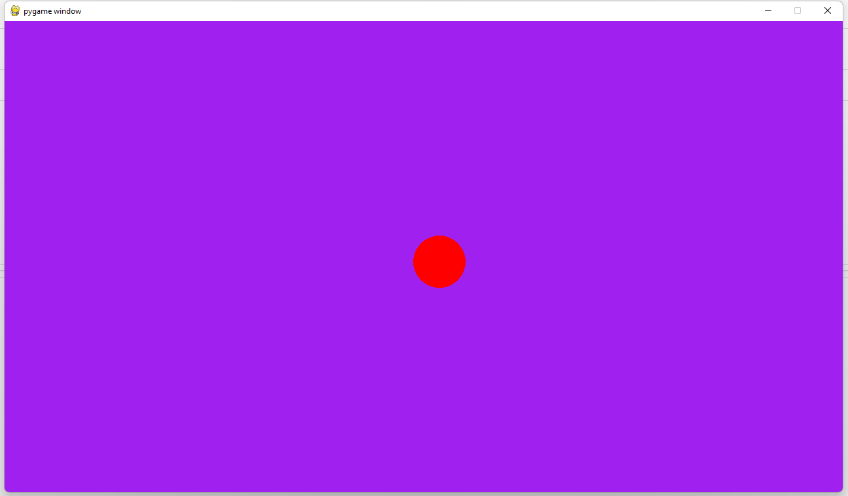

Let's Start Thinks About Apps
Pygame is a free and open-source cross-platform library for the development of multimedia applications like video games using Python
Where do we start? We need an awesome dev team, and idea that slaps
Let’s start brainstorming!

